Slide 1
Forecasting

Slide 2
Review - Forecasting
Similar to regression, predict a target that has numeric types
However, usually involving a time dimension in the data – future values are predicted based on current and historical data
Examples:
Predict future stock prices
Predict future product sales
Like regression, this is a supervised learning task
Date | Open | High | Low | Close
1/4/2022 | 334.83 | 335.2 | 326.12 | 329.01
1/5/2022 | 325.86 | 326.07 | 315.98 | 316.38
1/6/2022 | 313.15 | 318.7 | 311.49 | 313.88
1/7/2022 | 314.15 | 316.5 | 310.09 | 314.04
1/10/2022 | 309.49 | 314.72 | 304.69 | 314.27
1/11/2022 | 313.38 | 316.61 | 309.89 | 314.98
NextClose
316.38
313.88
314.04
314.27
314.98
???

Slide 3
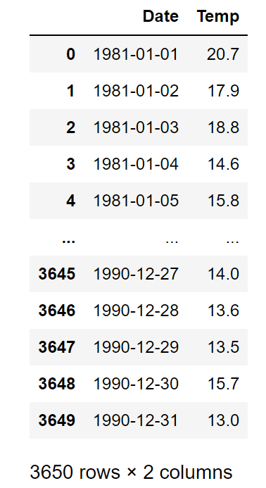
Example: Temperature Data
We will be using the daily minimum temperature data to demonstrate models in this module
The data has 3650 rows, each representing a day from 1/1/1981 until 12/31/1990
Columns are Date and Temp
We will need to transform this data to the features – target format before being able to model with it

Slide 4
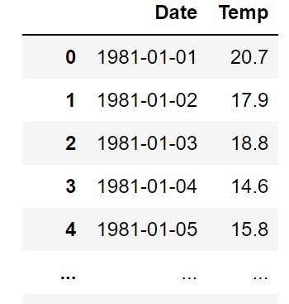
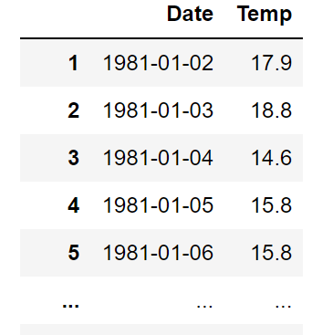
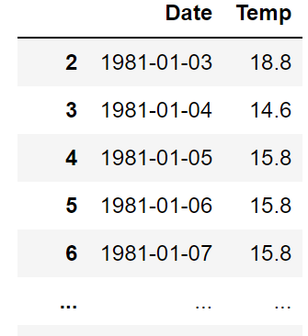
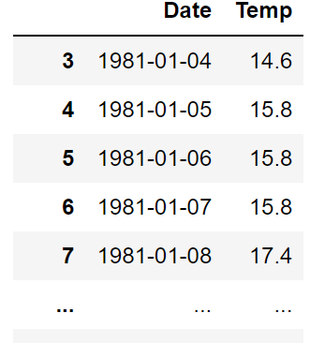
Predicting Next Day Temperature
As can be seen, the only feature in this data is Temp.
Date is a timestamp and cannot be used in models directly. It can be transformed to features such as week, month, quarter, season, holiday, etc. if needed. However, we will not do that in this example
We want the data to be in the following format
Features are temperature data until the current day. Days before that are acceptable
Target is next day temperature
Features
Target

Slide 5
Modeling
After transformation, the data can be modeled like normal regression data
However, we usually split train/test by time, not randomly. For example, the first nine years are used for training and validation, and the last year is for testing
Note: there are advance deep learning models that can automatically learn historical data without defining windows. However, we will not discuss them in this course.

Slide 6
Window Size and Performance
In general, larger window sizes mean going further into history from each current time point, and are potentially better
Depending on the nature of the data, this is not always true
The improvement can also be marginal compared to the increase in model complexity
 | Window = 5 | Window = 10
SVR | 0.657 | 0.672
Decision Tree | 0.627 | 0.611
Random Forest | 0.654 | 0.664
Neural Network | 0.650 | 0.666
Testing $R^{2}$ of models in the Daily Temperature data using different window sizes

